Slide 1

Machine learning and computer vision in TensorFlow
Notes:
‹#›

Slide 2
Objectives
Understand Machine Learning in TensorFlow
Understand Computer Vision in TensorFlow
Examples
Machine learning and computer vision in TensorFlow
‹#›

Slide 3
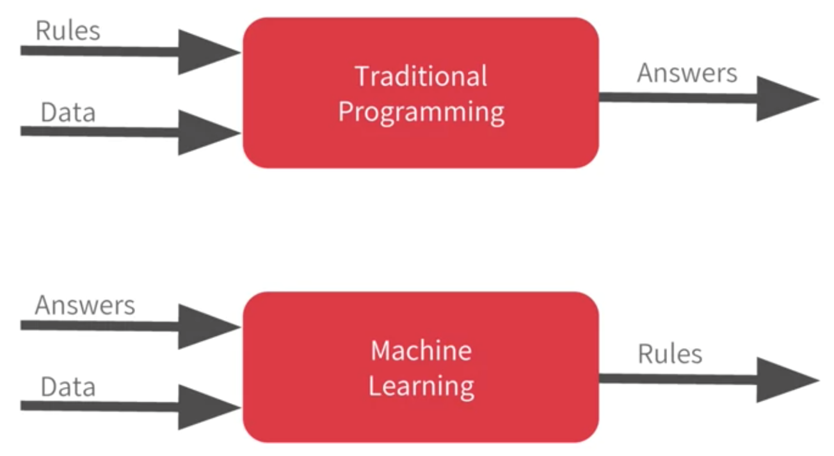
Machine Learning in TensorFlow
Machine learning rearranges this diagram where we put answers in data in and then we get rules out
Machine learning and computer vision in TensorFlow
‹#›
Notes:
‹#›

Slide 4
Machine Learning in TensorFlow
TensorFlow is a rich system for managing all aspects of a machine learning system.
TensorFlow APIs are arranged hierarchically, with the high-level APIs built on the low-level APIs.
Machine learning researchers use the low-level APIs to create and explore new machine learning algorithms
Machine learning and computer vision in TensorFlow
‹#›
Notes:
‹#›

Slide 5
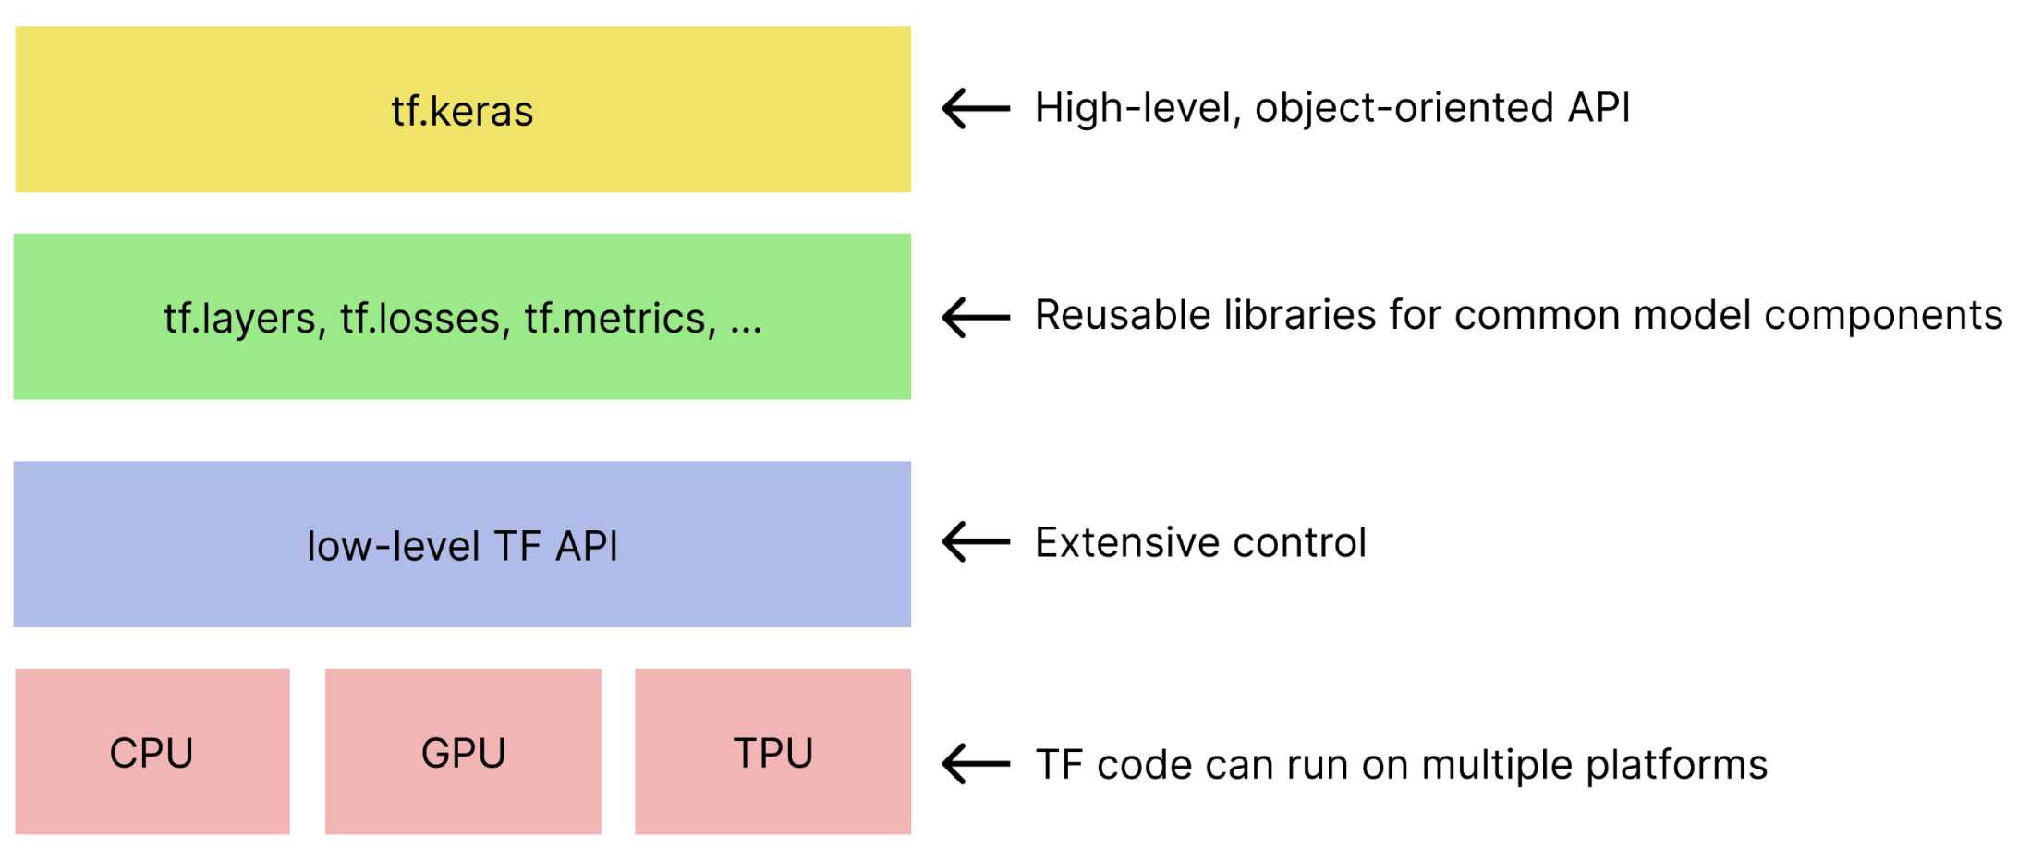
Machine Learning in TensorFlow
The hierarchy of TensorFlow toolkits
Machine learning and computer vision in TensorFlow
‹#›
Notes:
‹#›

Slide 6
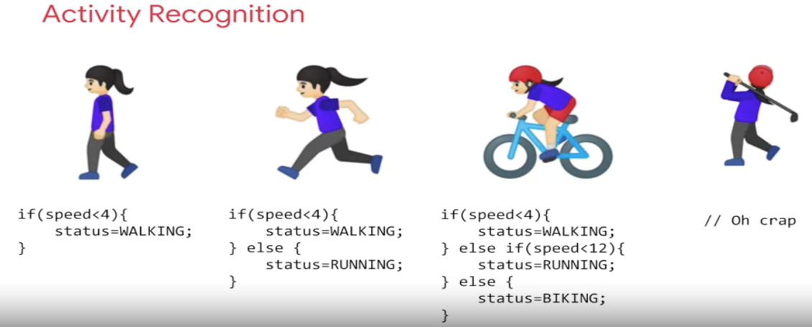
Machine Learning in TensorFlow
Example: detects if somebody is say walking, running, biking when we have data about their speed
What do we need to solve the problem above ?
Machine learning and computer vision in TensorFlow
‹#›
Notes:
‹#›

Slide 7
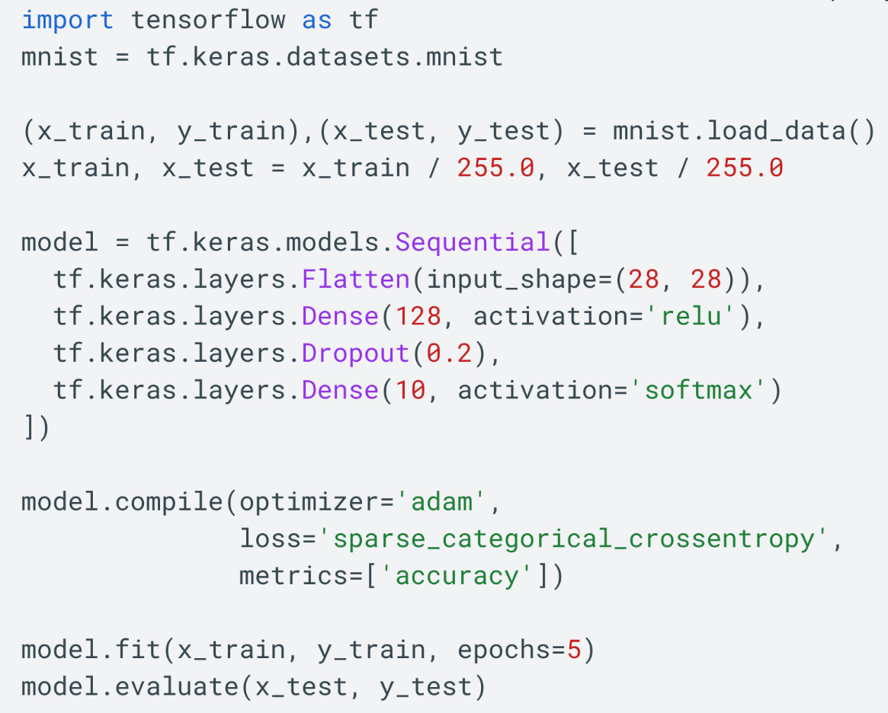
Machine Learning in TensorFlow
Example
Group discuss about the code above
Machine learning and computer vision in TensorFlow
‹#›
Notes:
‹#›

Slide 8
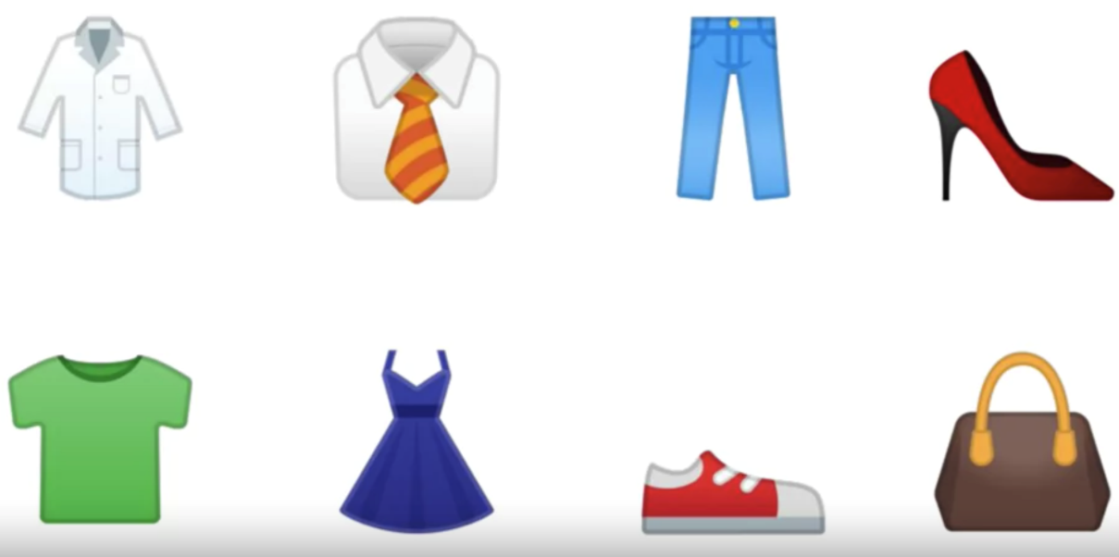
Computer Vision in TensorFlow
Computer vision is the field of having a computer understand and label what is present in an image.
How can a computer interpret what a shirt is or what a shoe?
Machine learning and computer vision in TensorFlow
‹#›
Notes:
‹#›

Slide 9
Computer Vision in TensorFlow
Use lots of pictures of clothing and tell the computer what that's a picture of and then have the computer figure out the patterns that give you the difference between a shoe, and a shirt, and a handbag, and a coat.
Machine learning and computer vision in TensorFlow
‹#›
Notes:
‹#›

Slide 10
Computer Vision in TensorFlow
TensorFlow provides a number of computer vision (CV) and image classification tools.
KerasCV is a library of modular CV components built on Keras Core.
KerasCV includes models, layers, metrics, callbacks, and other tools that extend the high-level Keras API for CV tasks.
The KerasCV APIs can help with data augmentation, classification, object detection, segmentation, image generation, and other common CV workflows.
Machine learning and computer vision in TensorFlow
‹#›
Notes:
‹#›

Slide 11
Computer Vision in TensorFlow
Keras utilities
tf.keras.utils provides several high-level image preprocessing utilities. For example, tf.keras.utils.image_dataset_from_directory generates a tf.data.Dataset from a directory of images on disk.
tf.image
If KerasCV doesn't fit your use case, you can use tf.image and tf.data to write your own data augmentation pipelines or layers.
The tf.image module contains various functions for image processing, such as tf.image.flip_left_right, tf.image.rgb_to_grayscale, tf.image.adjust_brightness, tf.image.central_crop, and tf.image.stateless_random*.
Machine learning and computer vision in TensorFlow
‹#›
Notes:
‹#›

Slide 12
Computer Vision in TensorFlow
TensorFlow Datasets is a collection of datasets ready to use, with TensorFlow or other Python ML frameworks.
All datasets are exposed as tf.data.Datasets , enabling easy-to-use and high-performance input pipelines.
Machine learning and computer vision in TensorFlow
‹#›
Notes:
‹#›

Slide 13
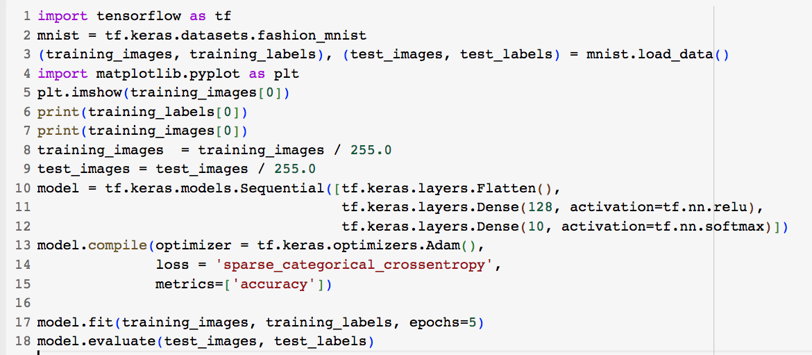
Computer Vision in TensorFlow
Group discuss about the code below:
Machine learning and computer vision in TensorFlow
‹#›
Notes:
‹#›

Slide 14
Summary
Understand Machine Learning in TensorFlow
Understand Computer Vision in TensorFlow
Examples
Machine learning and computer vision in TensorFlow
‹#›

Slide 15
Q & A
Machine learning and computer vision in TensorFlow
‹#›

